Slide 1

Toronto Crime Review by Neighborhood
Presented by:
Khaled Hyder
ID: 500800613

Slide 2
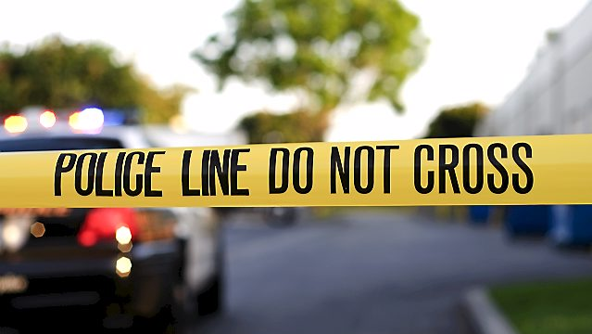
Problem Statement
“Crime in Toronto has been relatively low in comparison to other major cities. A 2017 ranking of 60 cities by The Economist ranked Toronto as the fourth safest major city in the world and the safest major city in North America” [1] as cited in Wikipedia.
Despite this report, Toronto has a fair share of crime. The city consists of 140 neighborhood. As we have seen in other big cities, some areas are relatively unsafe considering the count of major crime indicator.
In this project, we will try to identify most safe and unsafe neighborhoods in Toronto and also try to discover any hidden pattern of crime data through visualization.

Slide 3
Dataset Description and Technology used
Dataset
The dataset I have used in this project is from Toronto’s Open data which was provided by Toronto police service.
This dataset consists of 29 attributes(Columns) and 131,073 crime instances(Rows) which includes crime data from 2014 to 2017
Following Technology Used in this project:
R (8 Libraries for Data manipulation and Visualization)
D3
Machine Learning Algorithm – k means clustering

Slide 4
Challenges:
Data Collection: Unavailability of updated neighborhood wise social data.
Geo-Plotting – Limitation of Google API and uses of “ggmap” and “maps” R library for visualization.
Data wrangling: Arrange dataset for different output.

Slide 5
Data Pre-processing:
Remove Duplicate: I had to remove 17K duplicate data.
Feature selection: Out of 29, I have manually selected 15 features.
Reported year vs. Occurrence year: During exploration, I have found many incidents occurred from 2000 to 2016 but reported in 2017. The number was not significant thus I had deleted the backdated incidents
Year Selection: This dataset consists major crime reported from 2014 till 2017, for this project I have selected the year 2017 the most recent year to categorize the offense within neighbors.

Slide 6
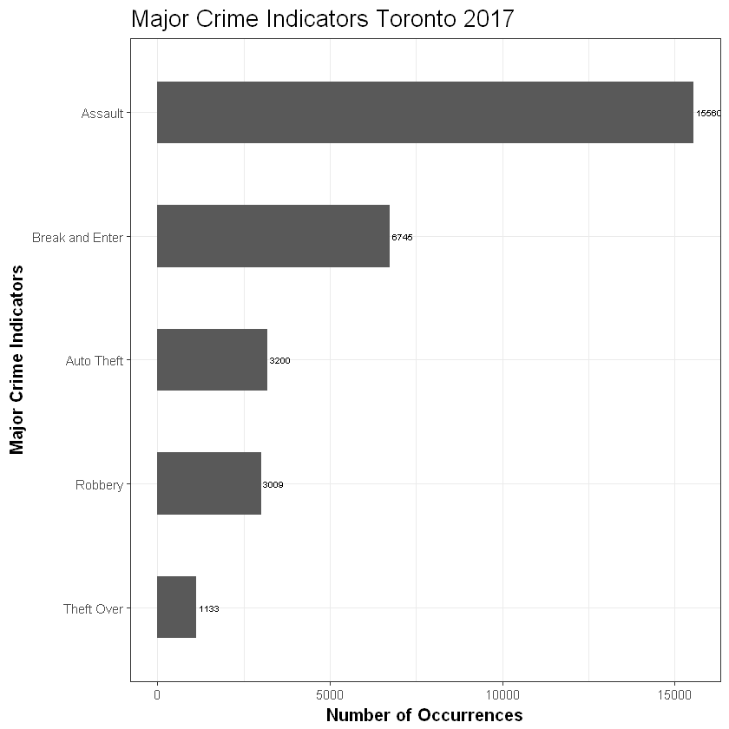
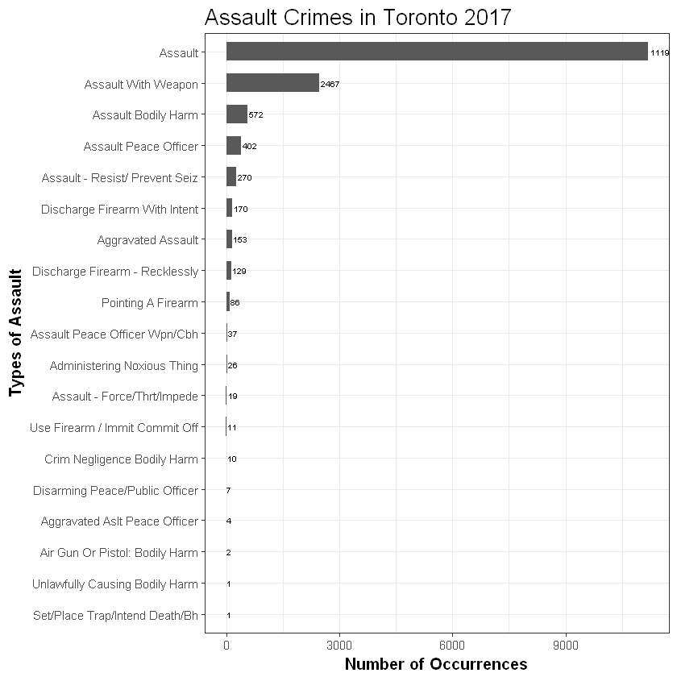
Major Crime Indicators and assault crimes (2017)
According to civil and criminal law, “assault is an attempt to initiate harmful or offensive contact with a person, or a threat to do so.”

Slide 7
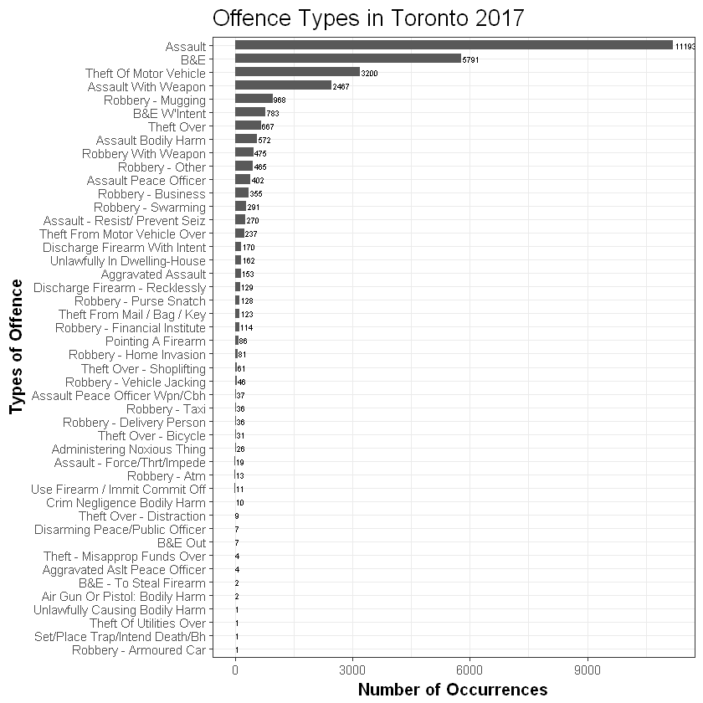
Top Offences in Toronto:
Here we can see, break and enter(B&E) is the second most frequent offense in Toronto, according to definition B&E refers, “situations where the accused was or attempted to trespass on private property with an intent to commit an indictable offense. The most typical form of break and enter is breaking into a commercial or private residence to steal property.”

Slide 8
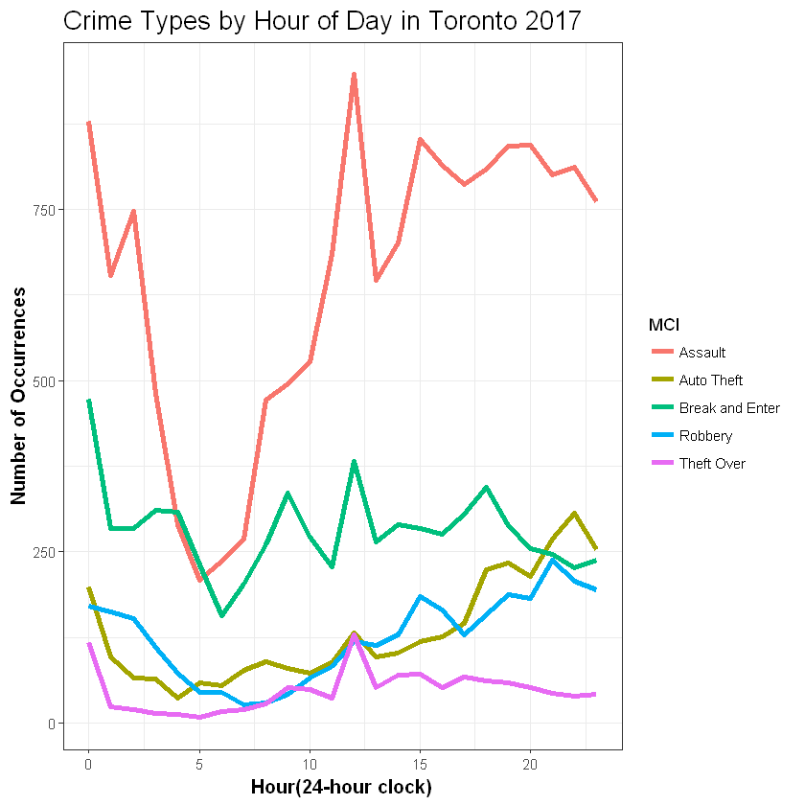
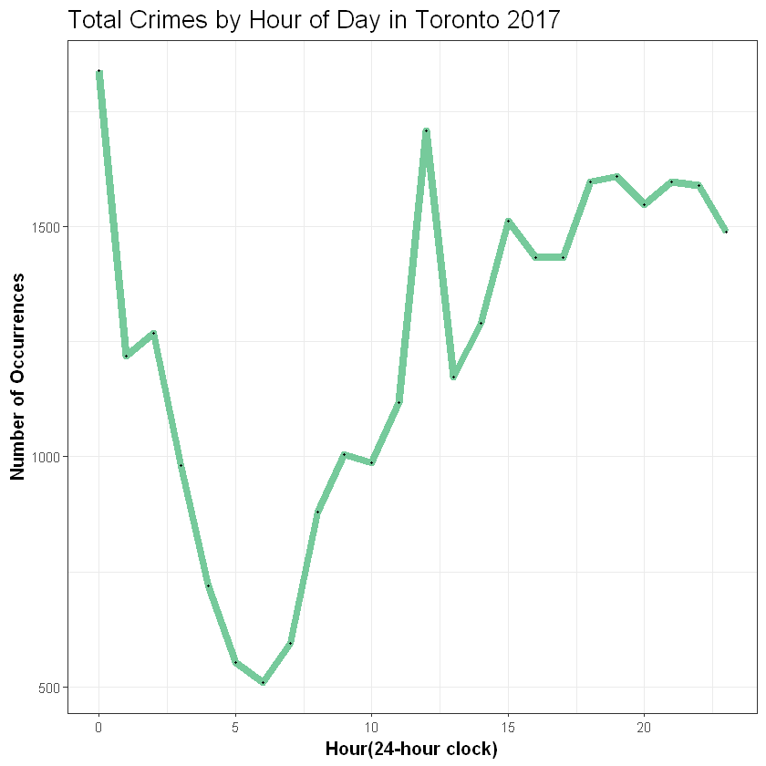
Total Crimes by Hour in Toronto in 2017

Slide 9
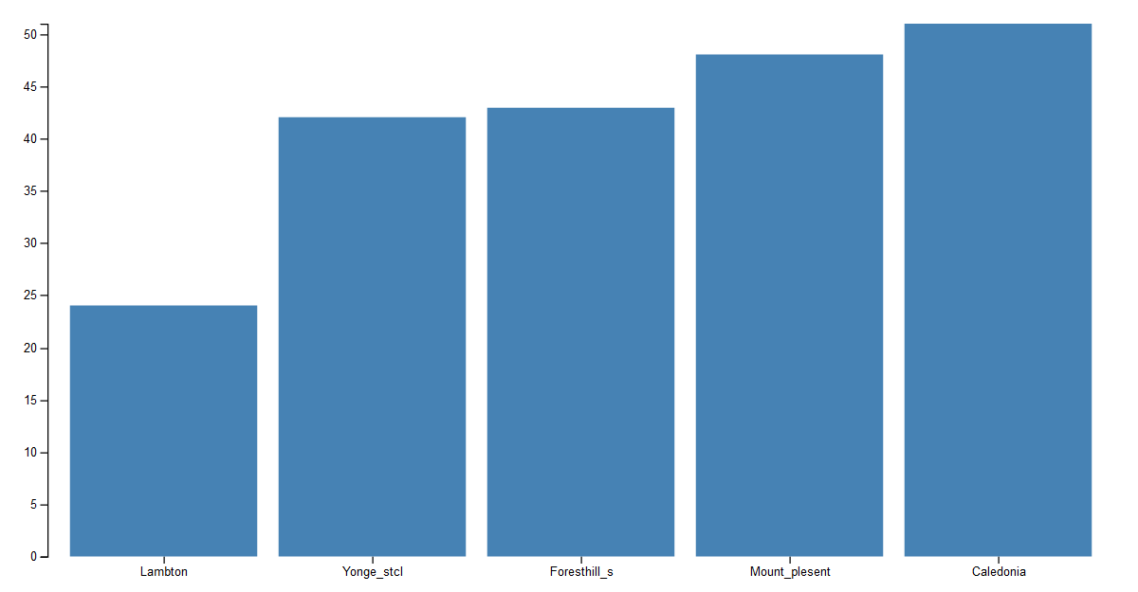
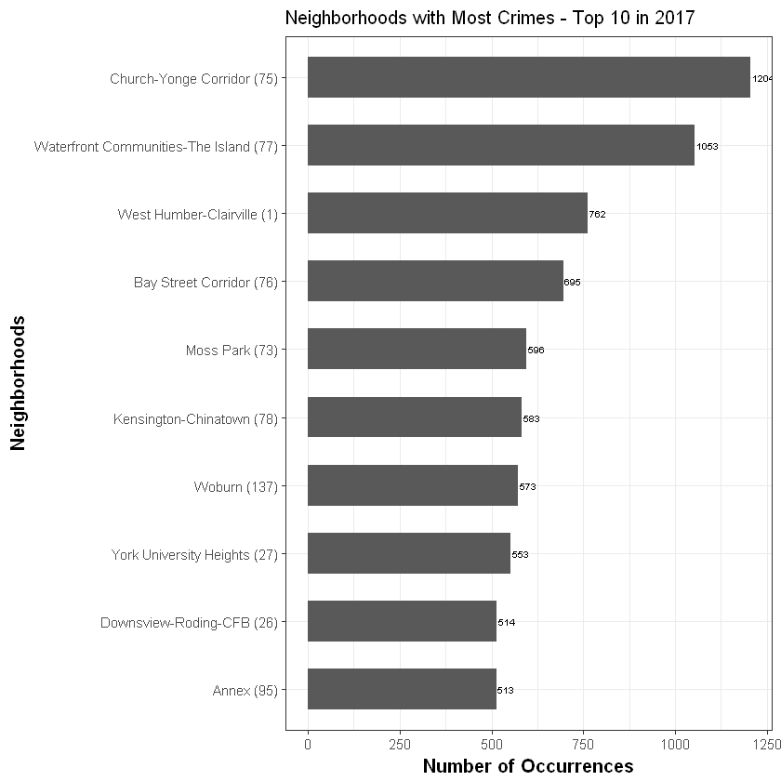
Neighborhood with most and least Crime in 2017:

Slide 10
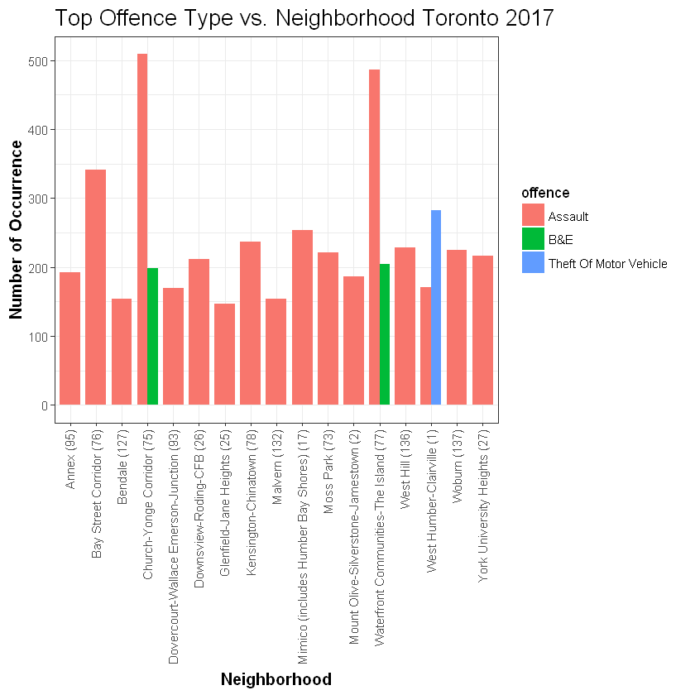
The Offence Type vs. Neighbourhood in 2017:
The most dangerous neighborhood, Church-Yonge corridor, and waterfront were well known for assaults and Break and Enter so if you are living these areas, please put an extra lock on your residence. And don’t park your car at West Humber.

Slide 11
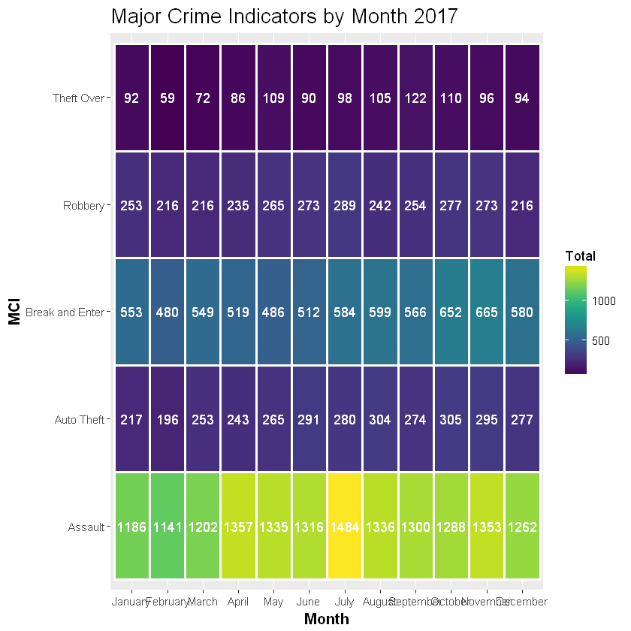
Major Crime Indicators Month wise in 2017:

Slide 12
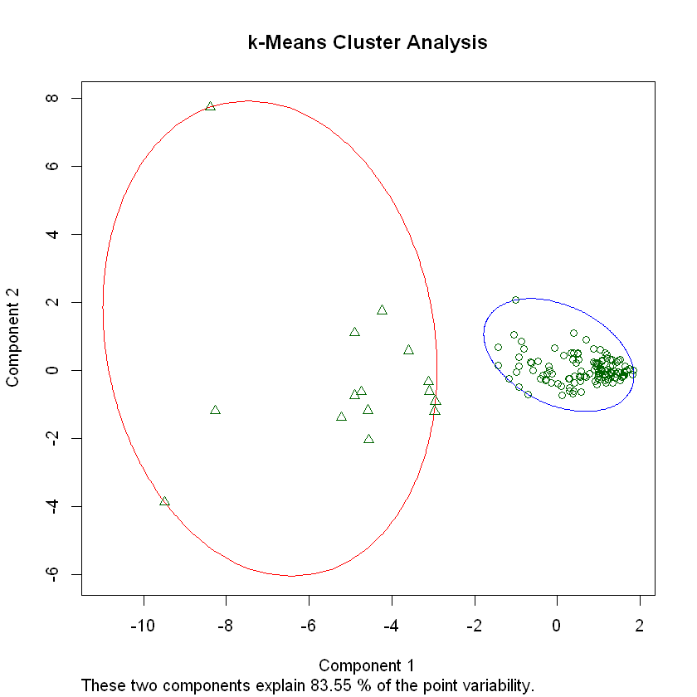
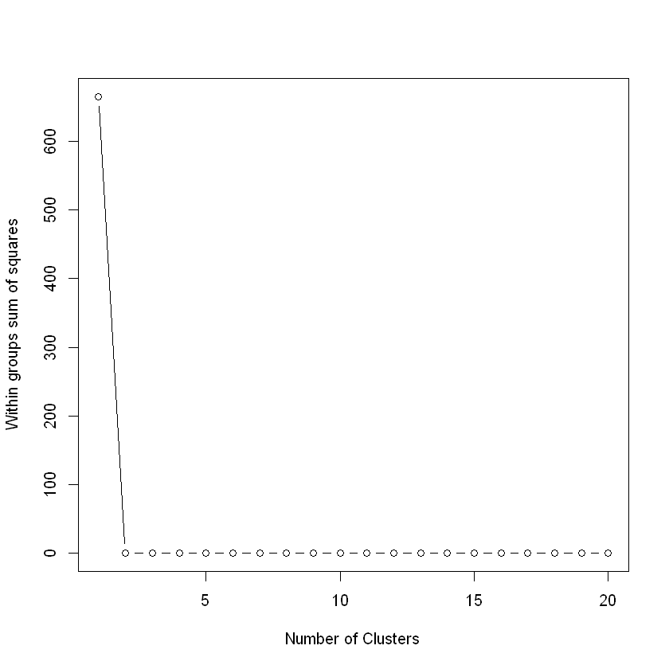
Clustering the neighborhoods
15 N
Low mean value
119 N
High mean value
Notes:
Here we have 2 clusters, 1st one has 119 and the second one has 15 neighborhoods. That 1st cluster has a negative mean value which indicates neighborhoods with low assault, auto theft, and other crimes. On the other hand, the high mean value of cluster 2 shows those neighborhoods that have high assault and other crime parameters.
K-means clustering with 2 clusters of sizes 119, 15
Cluster means:
Assault Auto Theft break Robbery Theft Over
1 -0.2619095 -0.1504037 -0.2245636 -0.2592723 -0.2655921
2 2.0778151 1.1932031 1.7815378 2.0568934 2.1070309
Clustering vector:
[1] 1 1 1 2 1 1 2 1 1 1 1 2 1 1 1 1 1 1 1 1 1 1 1 2 1 1 1 1 1 1 1 2 2 1 1 1 1
[38] 1 1 1 1 1 1 1 1 1 1 1 1 1 1 1 1 1 1 1 1 2 1 1 1 2 1 1 1 1 1 1 1 1 1 1 1 1
[75] 1 1 1 2 1 1 1 1 1 1 1 1 1 1 1 1 1 1 1 1 1 1 1 1 1 1 1 1 1 1 1 1 1 1 1 1 1
[112] 1 1 1 1 1 1 1 2 2 2 1 1 1 1 2 1 1 2 1 1 1 2 1
Within cluster sum of squares by cluster:
[1] 169.0590 198.9117
(between_SS / total_SS = 44.7 %)
Available components:
[1] "cluster" "centers" "totss" "withinss" "tot.withinss"
[6] "betweenss" "size" "iter" "ifault"

Slide 13
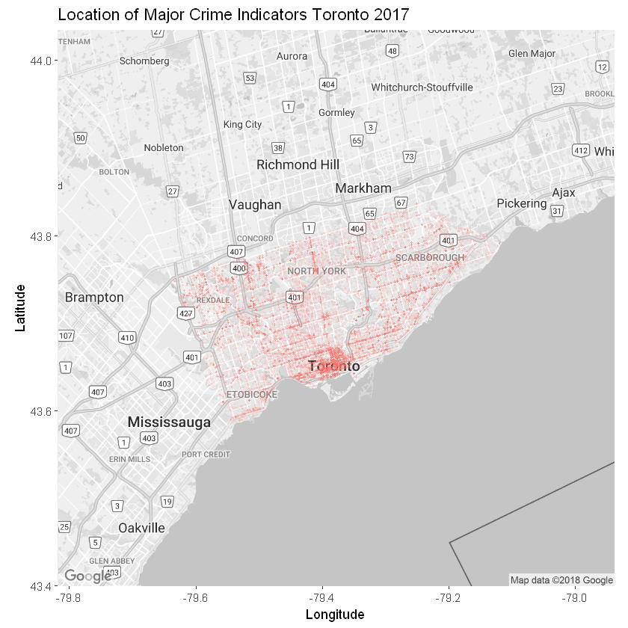
Conclusion and Geo-Visualization:
Possible to apply machine learning to identify the reason.
Authority can take preventive measurements.

Slide 14
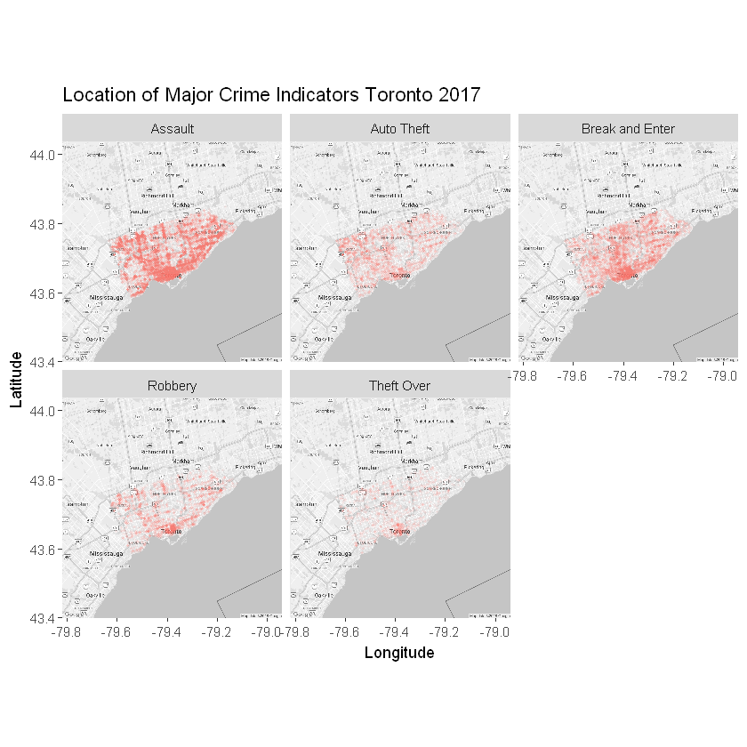

Robbery and Theft-over more frequent in the downtown area

Slide 15
Thank You

